Slide 1
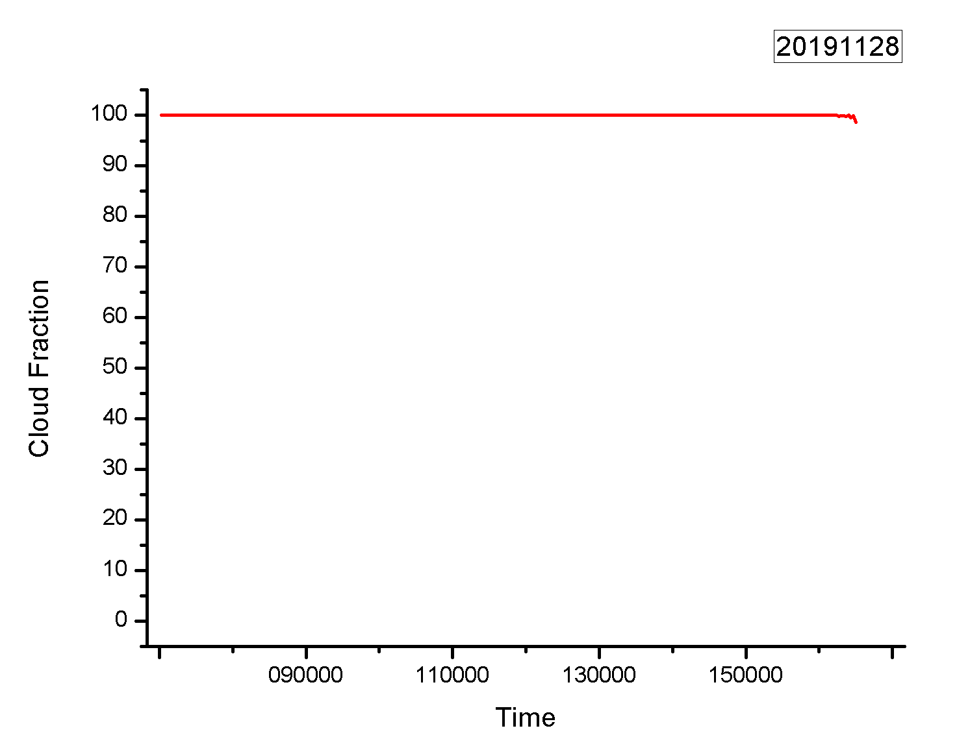
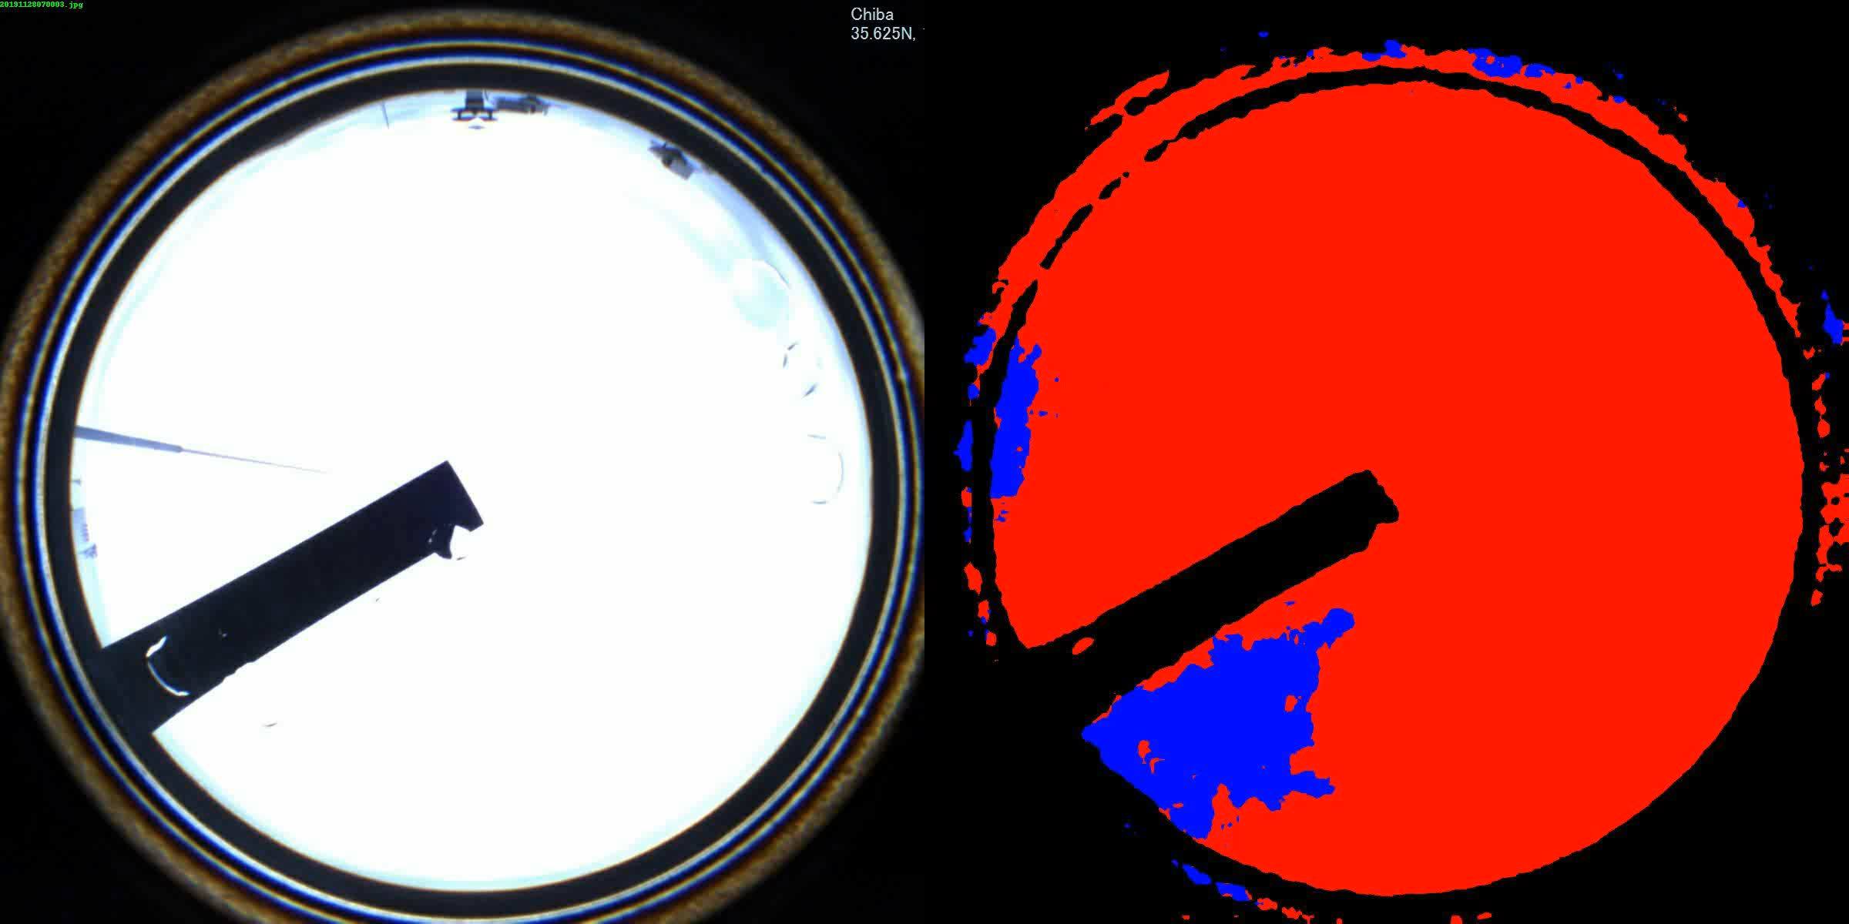
Cloud Fraction
2019.11.28
The video about skyview images and their segmentation
Cloud fraction

